Slide 1
Physical Activity
Active People Survey
www.jsna.info
Active People Survey
Adults age 16 and over doing 30 minutes of moderate intensity sport
The Active People Survey has been carried out by Sport England on an almost annual basis since 2005. The survey records adults’ level of activity in sport and exercise as well their attitudes towards them.
The results of the 5th Active People Survey (2010/11) found that roughly, 19% of tri-borough residents participate in three sessions of 30 minutes of moderate intensity sport per week, roughly 58% participate in less than one session per week. Residents are more likely to participate in sport than is average for London and England.
The 2010/11 results suggest that the amount of exercise residents participate in is similar to the previous four years of the survey.
The survey suggests that younger and working age adults state ‘work commitments’ as the biggest barrier to participating in sport. Middle-age and older people stated ‘Health, injury or disability’ as the biggest barrier to participating in sport.
 | Less than once per week | Once or twice per week | Three or more times per week
Hammersmith & Fulham | 56% | 25% | 19%
Kensington & Chelsea | 58% | 22% | 20%
Westminster | 59% | 22% | 19%
Tri-borough | 58% | 23% | 19%
Useful Links
Active People Survey:
www.sportengland.org
Source: Sport England Active People Survey 6
© Crown copyright. All rights reserved. (2012)
Author: Public Health Intelligence Team

Slide 2
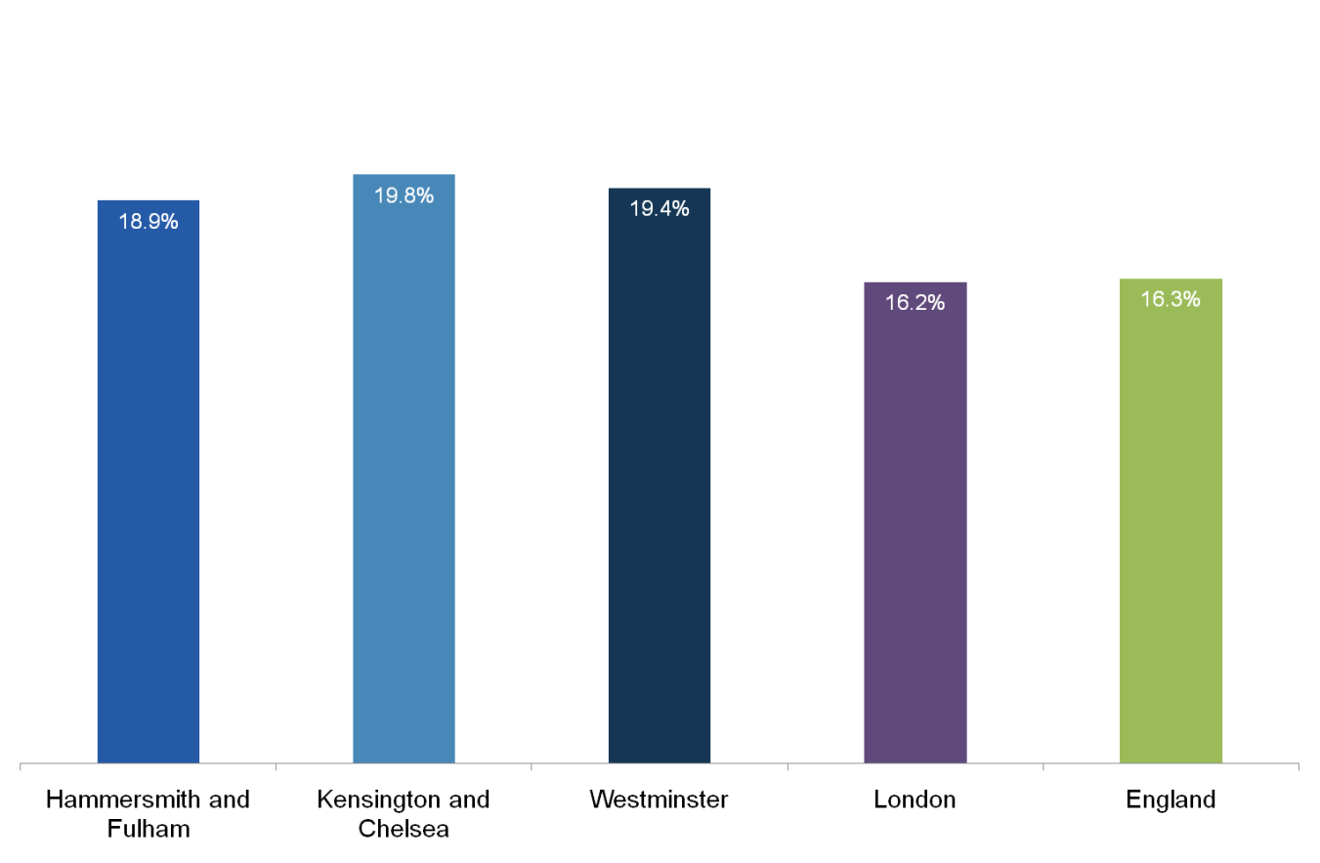
Physical Activity
Active People Survey – Participating in sport 3 times per week
www.jsna.info
Comments
• Responses to the Active People Survey suggest that just under a fifth of tri-borough residents participate in 30 minutes of moderate intensity sport 3 times per week
• This is higher than is average for both London and England, however this may reflect the younger demographic profile of residents in Hammersmith and Fulham, Kensington and Chelsea, and Westminster.
Percentage of adults aged 16 years or older who participate in 30 minutes of moderate intensity sport at least 3 times per week (2010/11)
Comparison Data
H&F | 18.9%
K&C | 19.8%
Westminster | 19.4%
London | 16.2%
England | 16.3%
Source: Active People Survey 5
© Crown copyright. All rights reserved. (2012)
Author: Public Health Intelligence Team

Slide 3
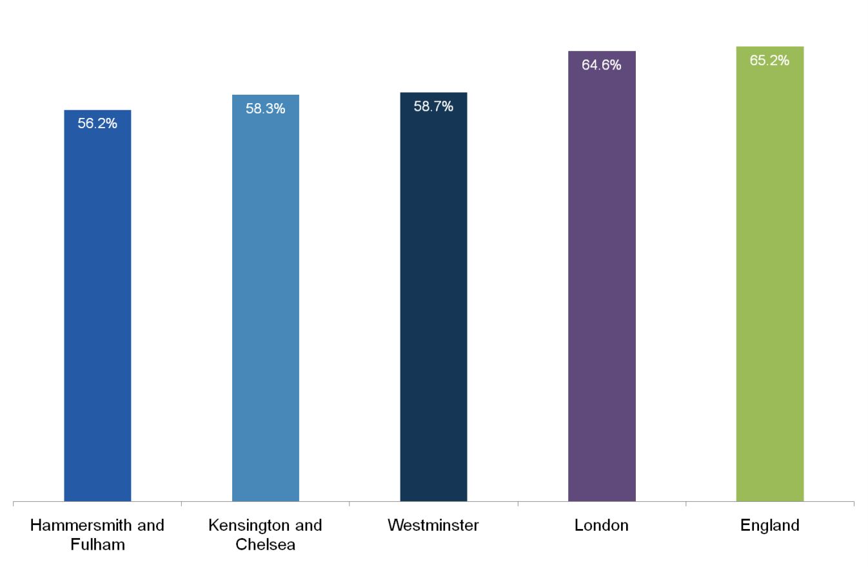
Physical Activity
Active People Survey – Participating in sport less than once per week
www.jsna.info
Comments
• Responses to the Active People Survey suggest that over half of tri-borough residents participate in 30 minutes of moderate intensity sport less than once per week.
• This is lower than is average for both London and England, however this may reflect the younger demographic profile of residents in Hammersmith and Fulham, Kensington and Chelsea, and Westminster.
Percentage of adults aged 16 years or older who participate in 30 minutes of moderate intensity sport less than once per week (2010/11)
Comparison Data
H&F | 56.2%
K&C | 58.3%
Westminster | 58.7%
London | 64.6%
England | 65.2%
Source: Active People Survey 5
© Crown copyright. All rights reserved. (2012)
Author: Public Health Intelligence Team

Slide 4
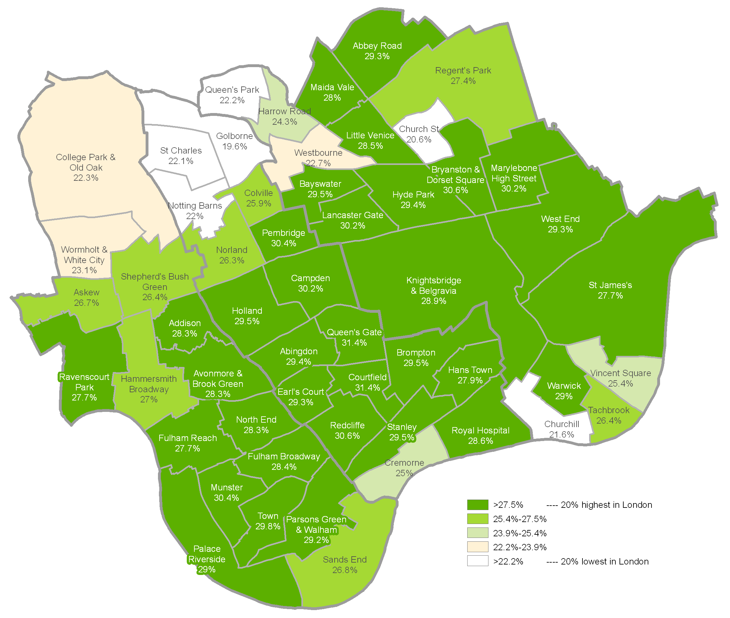
Physical Activity
Active People Survey – Participation in sport and active recreation by ward
www.jsna.info
Ward estimates of percentage of adults aged 16 years or older who participate in 30 minutes of moderate intensity sport or active recreation at least 3 times per week (2010/11)
Comments
• Estimates from the 5th Active People Survey suggest the Church Street, Queens Park, North Kensington and White City areas have some of the lowest levels of participation in sport and active recreation in London.
• In contrast, the more affluent areas of the tri-borough region are likely to be some of the most physical active in London and England.
Comparison Data
H&F | 27.4%
K&C | 25.1%
Westminster | 25.2%
Source: Active People Survey 5
© Crown copyright. All rights reserved. (2012)
Author: Public Health Intelligence Team

Slide 5
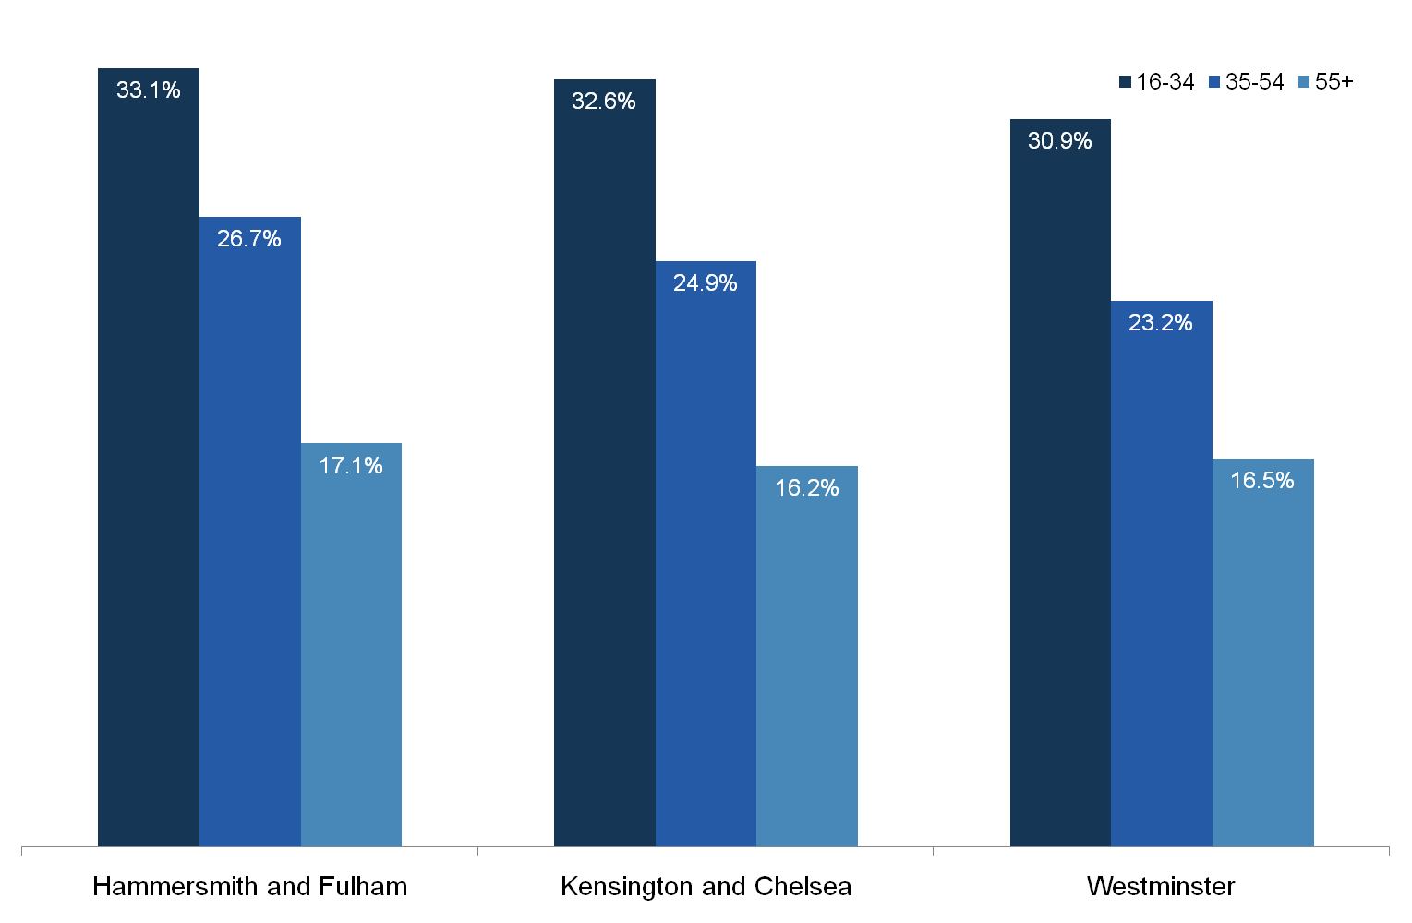
Physical Activity
Active People Survey – Participation in sport and active recreation by age
www.jsna.info
Proportion of adults who participate in 30 minutes of moderate intensity sport or active recreation at least 3 times per week by age (2010/11)
Comments
• Results from the Active People Survey show that younger working age adults are more likely to play sport or be physically active than middle-age and older people.
• Roughly one third of 16-34 year olds in the tri-borough region participate in 30 minutes of moderate intensity sport or active recreation 3 times per week. For 35-54 year olds the figure drops to roughly 25% and for 55+ year olds the figure is just over 15%.
Useful Links
Active People Survey:
www.sportengland.org
Source: Active People Survey 5
© Crown copyright. All rights reserved. (2012)
Author: Public Health Intelligence Team

Slide 6
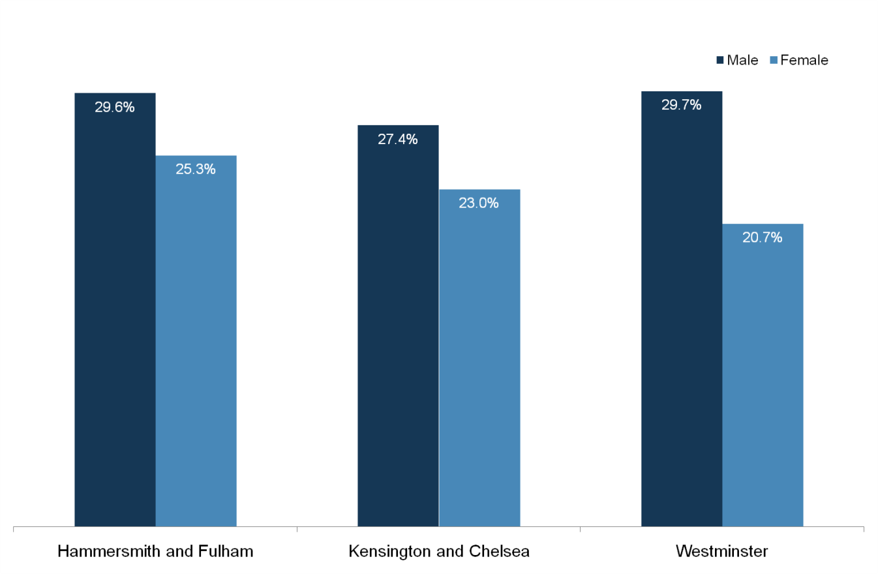
Physical Activity
Active People Survey – Participation in sport and active recreation by gender
www.jsna.info
Proportion of adults aged 16 years or older who participate in 30 minutes of moderate intensity sport or active recreation at least 3 times per week by gender (2010/11)
Comments
• Results from the Active People Survey show that men are more likely to play sport or be physically active than women.
• Just under a third of men resident in in the tri-borough area participate in 30 minutes of moderate intensity sport or active recreation 3 times per week. Amongst women the figure is just under one in four.
Useful Links
Active People Survey:
www.sportengland.org
Source: Active People Survey 5
© Crown copyright. All rights reserved. (2012)
Author: Public Health Intelligence Team

Slide 7
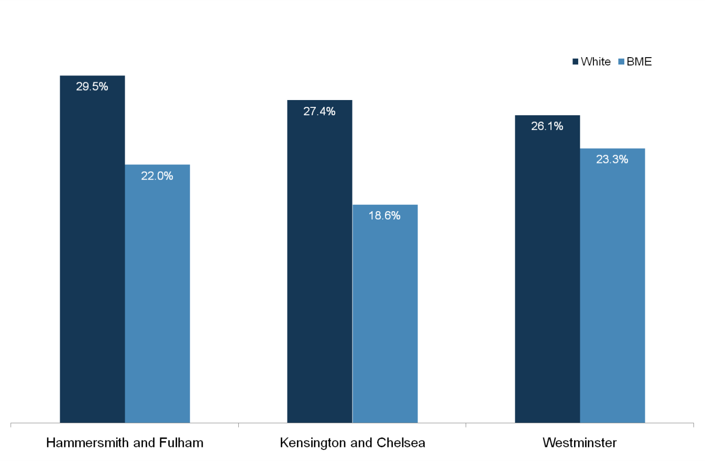
Physical Activity
Active People Survey – Participation in sport and active recreation by ethnicity
www.jsna.info
Proportion of adults aged 16 years or older who participate in 30 minutes of moderate intensity sport or active recreation at least 3 times per week by ethnicity (2010/11)
Comments
• Results from the Active People Survey show that adults from a white ethnicity are more likely to play sport or be physically active than adults from a Black, Minority or Other Ethnic (BME) group.
• Just over a quarter of white residents in the tri-borough area participate in 30 minutes of moderate intensity sport or active recreation 3 times per week. Amongst BME residents the figure is approximately one fifth.
Useful Links
Active People Survey:
www.sportengland.org
Source: Active People Survey 5
© Crown copyright. All rights reserved. (2012)
Author: Public Health Intelligence Team

Slide 8
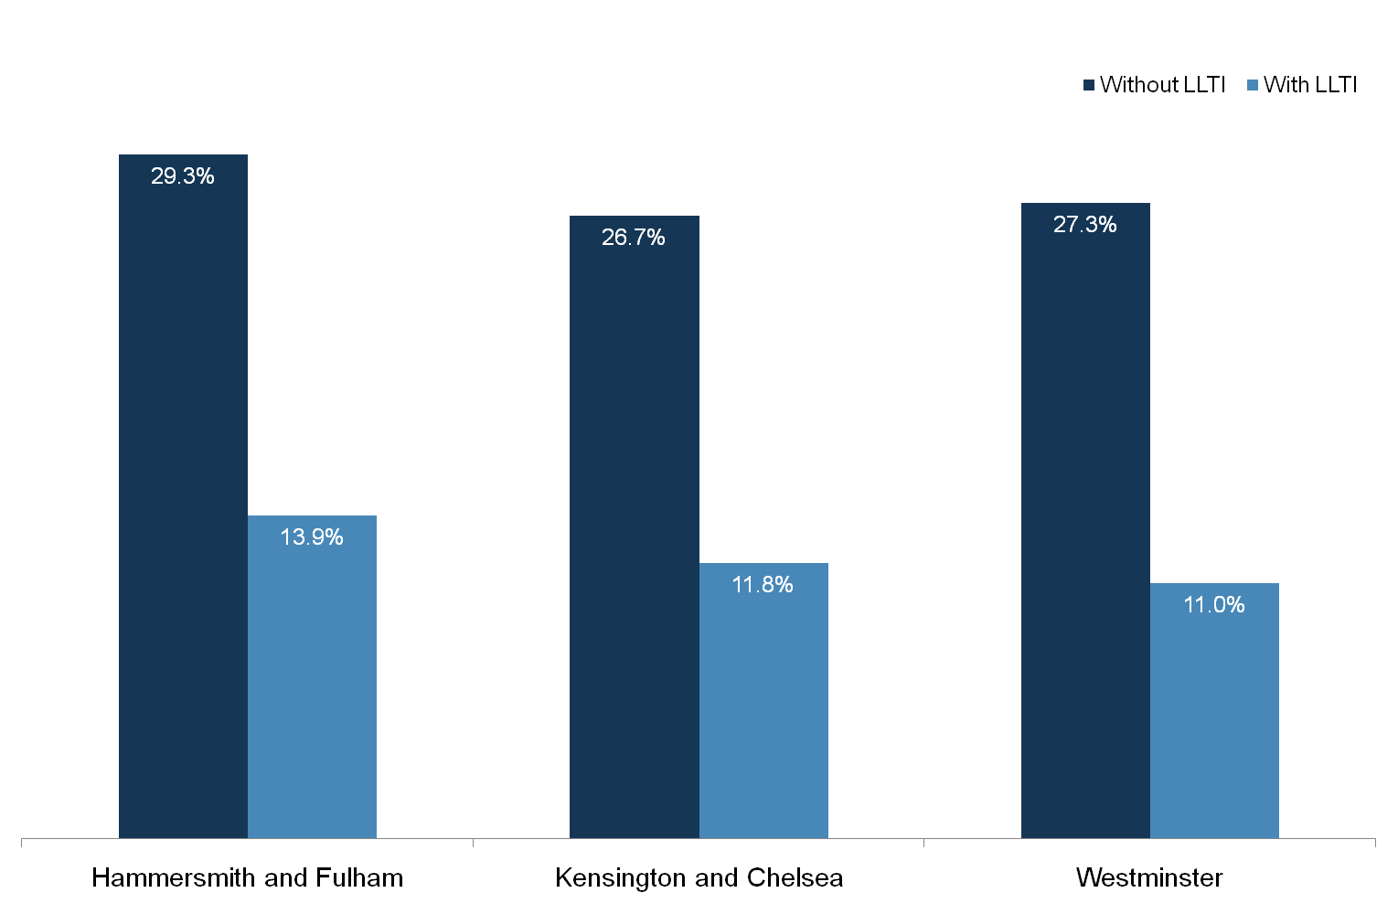
Physical Activity
Active People Survey – Participation in sport and active recreation by illness and disability
www.jsna.info
Proportion of adults aged 16 years or older who participate in 30 minutes of moderate intensity sport or active recreation at least 3 times per week by Limiting Long Term Illness (2010/11)
Comments
• Results from the Active People Survey show that people without a limiting long term illness (LLTI) are considerably more likely to play sport or be physically active than adults with an LLTI.
• Just over a quarter of residents without an LLTI living in the tri-borough area participate in 30 minutes of moderate intensity sport or active recreation 3 times per week. For residents with an LLTI the figure drops to just over one in ten.
Useful Links
Active People Survey:
www.sportengland.org
Source: Active People Survey 5
© Crown copyright. All rights reserved. (2012)
Author: Public Health Intelligence Team

